Slide 1
Øivind Tømmerås, Product Owner
Digital ocean
LNG cargo planner

Slide 2
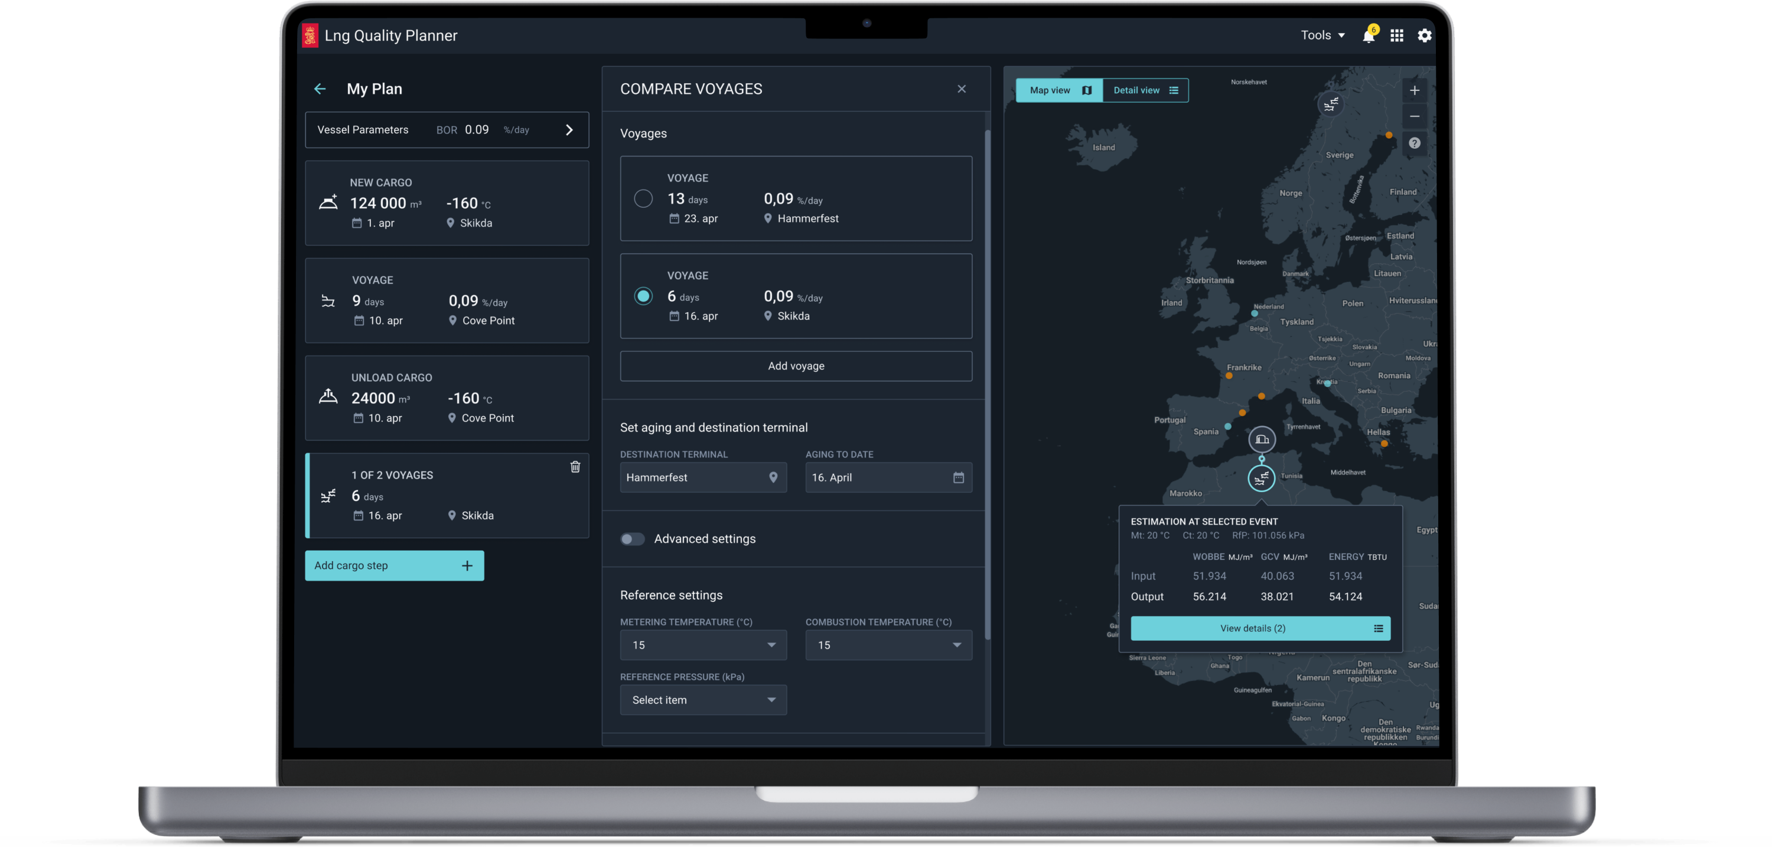
About
LNG quality Planner
The LNG cargo quality planner provides a simple solution for estimating aging of LNG, giving you more options, and allowing you to take more risk.
Without the planner it is cumbersome to have a clear and updated picture of the cargo quality evolution. Requiring higher margins and potentially missing out on opportunities.
Notes:
Value proposition:
The cargo quality planner easily gives me more options as I can take more risk given that I can estimate my cargo quality better (solution). Without the planner I would not have a clear picture of the cargo quality evolution in such an easy way (problem), and would have to add more margin and potentially miss out on some opportunities (value).
Input customer:
"Aging is the factor that is the risk factor"

Slide 3
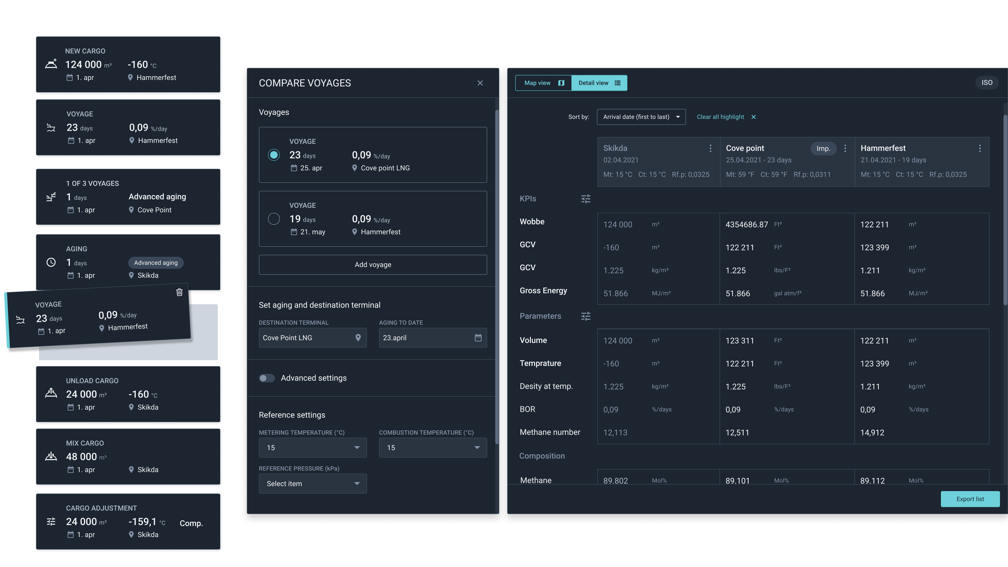
The application
LNG quality Planner
Gives you an easy and flexible way to verify the consequences of reshuffling your cargo to different destinations.​
Notes:
Simple setup key to actually do the calculations.

Slide 4
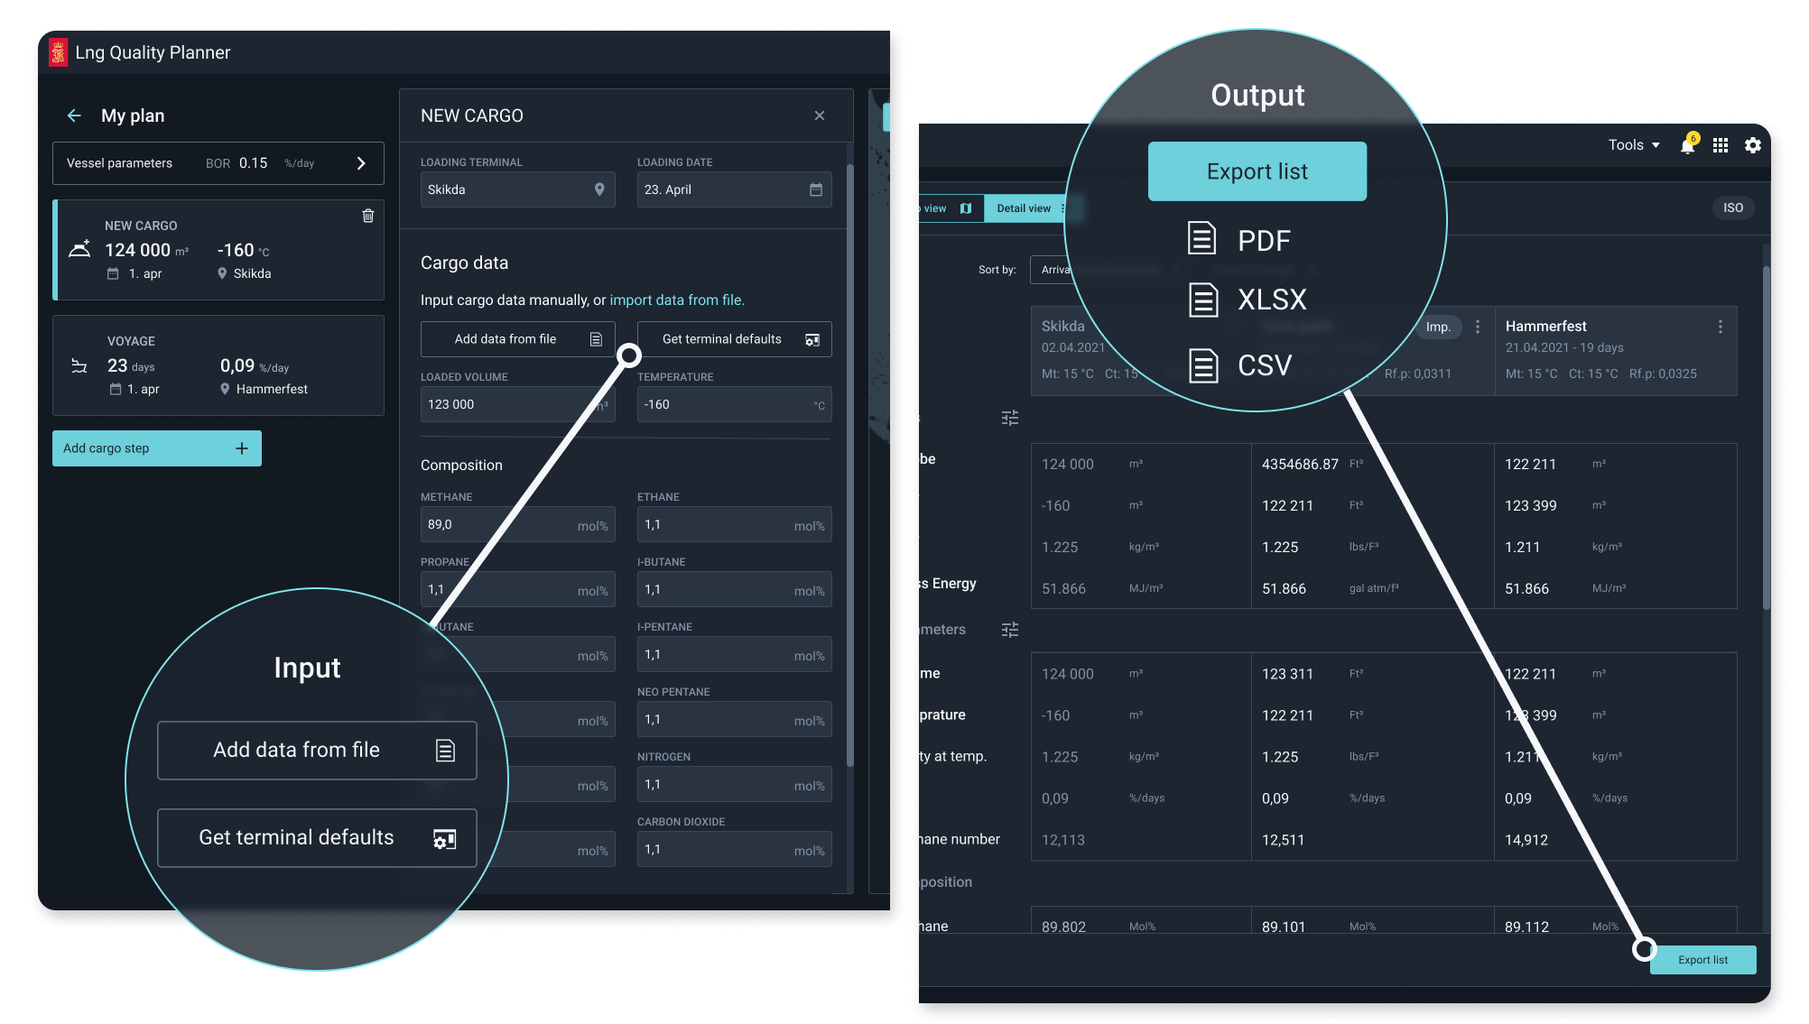
The application
LNG quality Planner
Quickly setup of cargo input using drag and drop of composition, volume and temperature.
Easy to export the estimated quality in different formats.

Slide 5
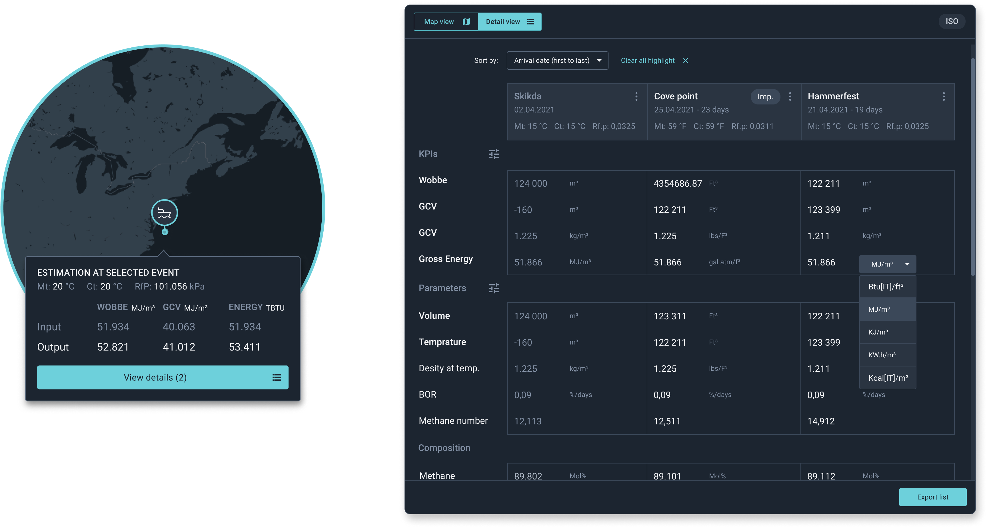
The application
LNG quality Planner
The output of the planner can easily adapt the Wobbe, GCV and other parameters to the units and references corresponding with contractual parameters.
Standards applied:
ISO6976
ISO6576
EN16726
PKI V1.2
Notes:
Input from customers:
When you have the values specified in the same way as the contract (units) it is very easy to compare because it is just check against a table

Slide 6
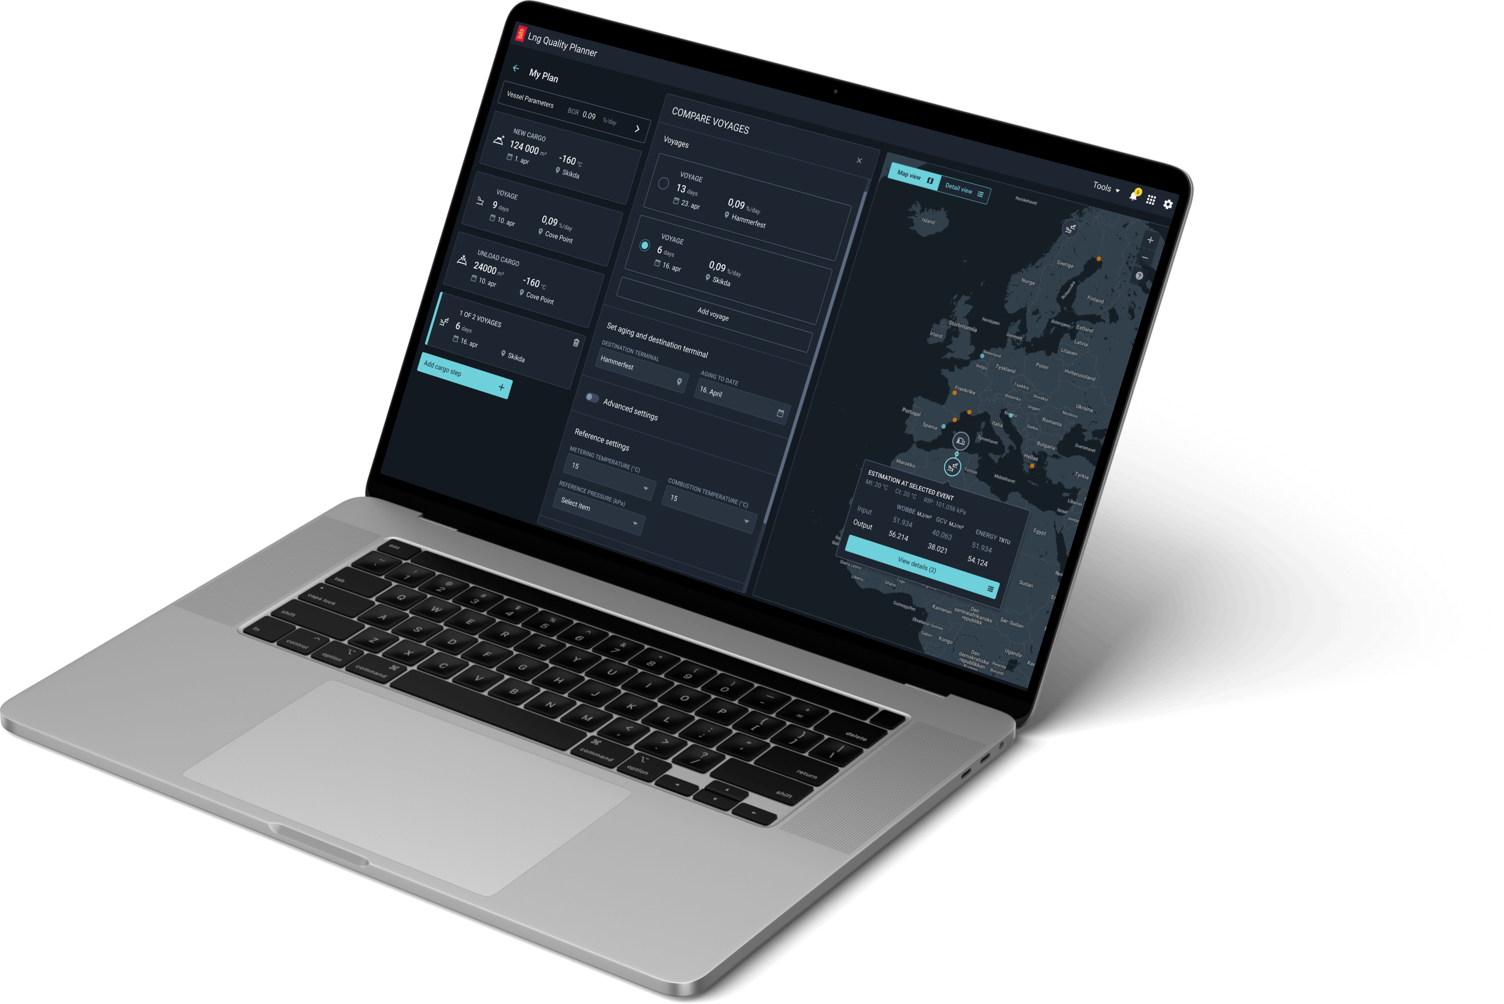
Future
LNG quality Planner
Further improve the speed and quality of doing cargo quality estimates by including ship data form Kongsberg Maritime sensors to provide real-time updates of your quality estimates.

Slide 7
END

